Slide 1
Reading @ Netherton
2025

Slide 2
Agenda
INTRODUCTION Reading Framework 2023
Guided Reading
Reading for Pleasure
Environments
Assessments Spelling @ Netherton

Slide 3

The Power of Reading

Slide 4
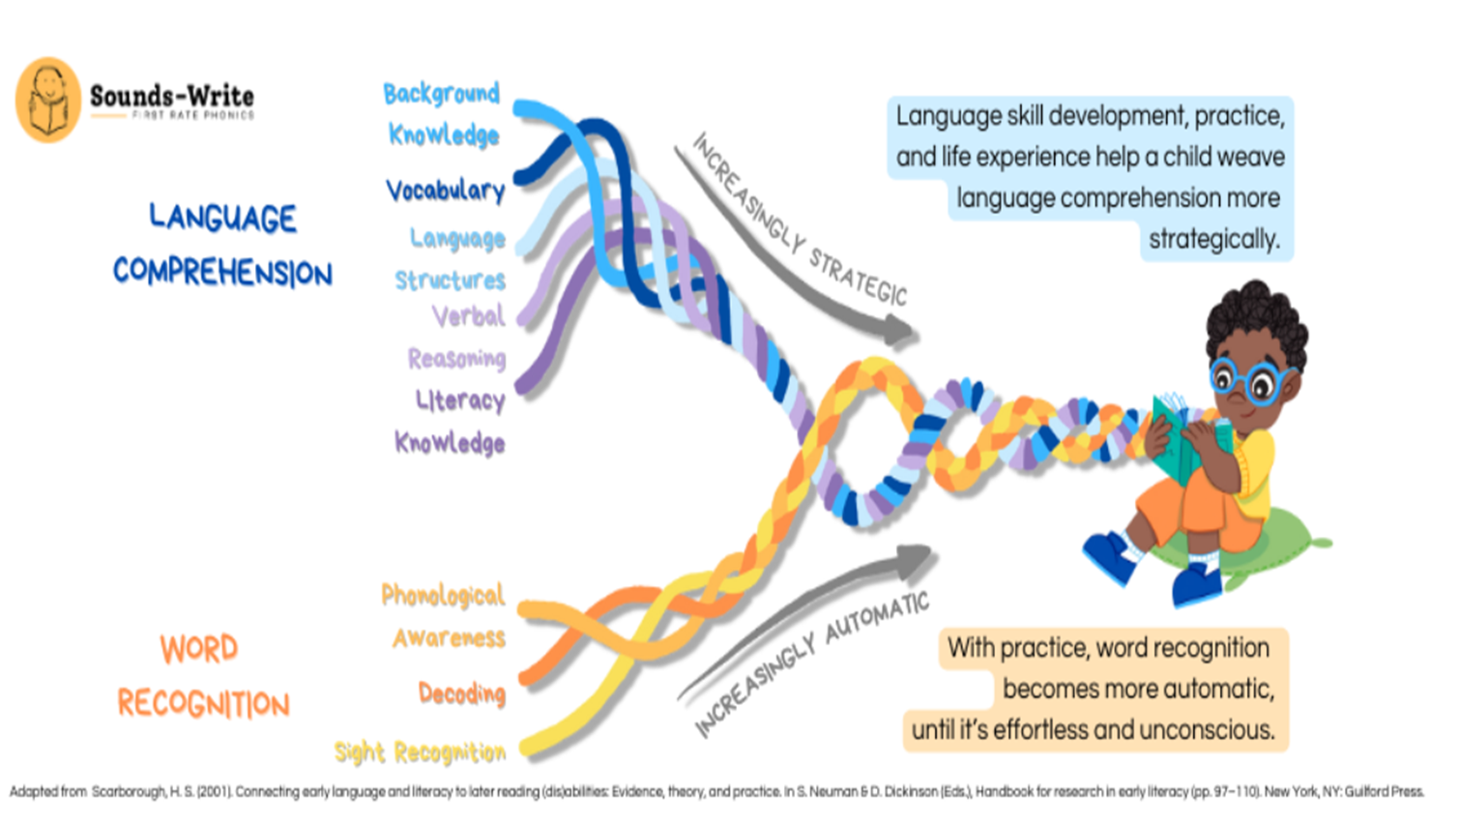
Reading Fluency

Slide 5
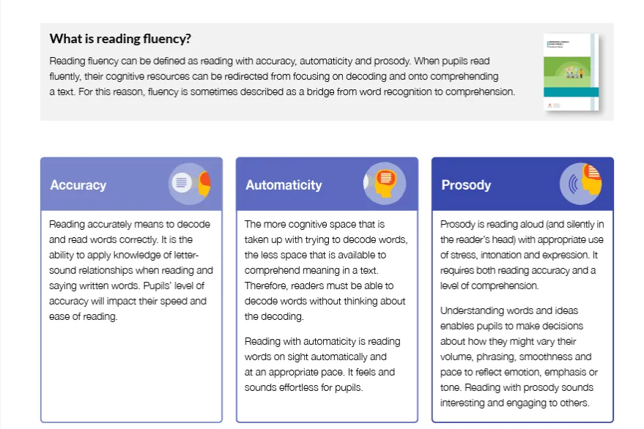

Slide 6
Herts For Learning: The Reading Fluency Project
https://www.hfleducation.org/reading-fluency
https://www.hfleducation.org/reading-fluency/key-stage-2-ks2-reading-fluency-project
Discuss HFL children and their ability to read fluently (TS, CM)
Our Reading Fluency Project works to significantly improve outcomes for pupils and is designed to help equip teachers to improve fluency and comprehension in a short space of time, across primary and secondary phases of education. The suite of key stage specific projects are based on a combination of well-evidenced strategies including:
modelled expert prosody
repeated reading
echo reading
text marking
performance reading
modelled comprehension

Slide 7
Guided Reading
Herts For Learning

Slide 8
The New Structure
Children will read an extract each week taken from the resource bank on the Reading Shed. Many of these Sheds have teaching slides that support the teaching of reading and comprehension.
Careful selection of these texts will be needed to ensure the children are being exposed to a range of texts such as information, narrative, biographies, poetry each half term. We will look at these closely in a short while.
The children need that exposure to high quality teacher modelling on the first session.
In UKS2 they also need to the opportunity for silent reading for SATs prep.
Guided reading will take place three times a week for twenty five minutes.( Times shown later)
Each session will focus upon building up that automaticity, prosody and skills to comprehend and respond.
This will replace the two hour sessions planned for WCR, Non-Fiction.

Slide 9
Monday | Tuesday | Wednesday | Thursday | Friday
 | 9:00 – 9:25 | 9:00 – 9:25 |  | 9:30 – 10:15
 | Text is introduced Silent reads UK2 Teacher modelling that expert prosody Assisted reading Partner reading Lots of oral discussion around the text. | Repeated reading a paragraph to model prosody Echo reading Vocabulary focus/check Quick fire retrieval Or tasks on vocabulary which can be recorded in the pupil’s books |  | Inference Using the evidence Explanation Modelling correct/incorrect answers Digging deeper for 3 marks. Using the task based activities to record answers in the pupil’s books
Reading for Pleasure | Reading for Pleasure | Reading for Pleasure | Reading for Pleasure | Reading for Pleasure
12:00 - 12:15 | 12:00 - 12:15 | 12:00 - 12:15 | 12:00 - 12:15 | 12:00 - 12:15

Slide 10

Resources and Planning
Show The Weather and Climate Teaching Slides
Look at The Reading Sheds
https://www.literacyshedplus.com/en-gb/browse/reading-shed
Show my MTP plan and discuss how I chose the text extracts.
Printed out overviews to hand out
Highlight texts that you could use this half term to get started with.
Future extracts could be taken from other areas like the guardian or news etc

Slide 11
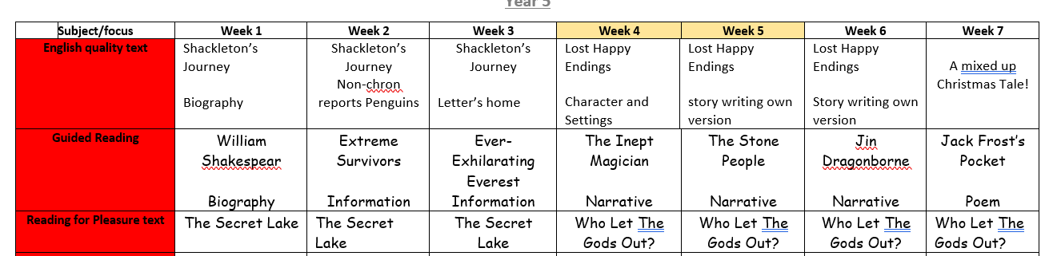

Slide 12
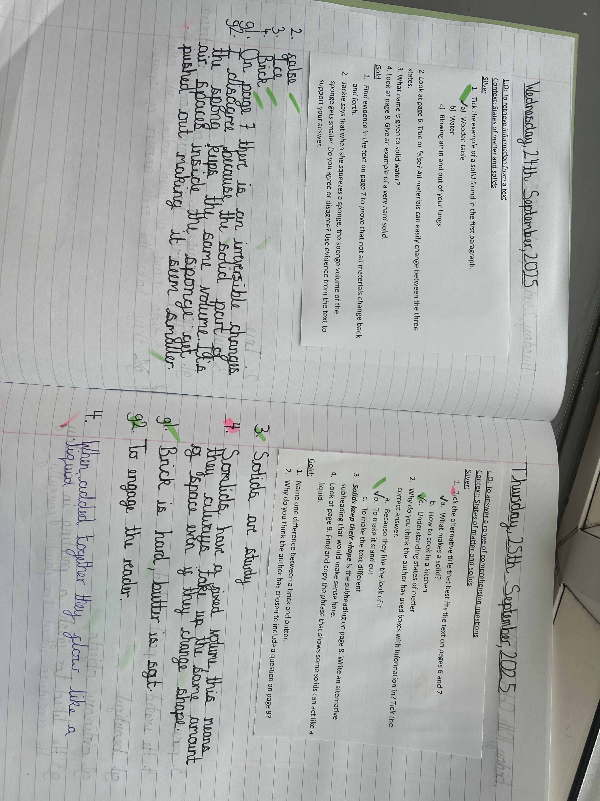
What should go into books?

Slide 13
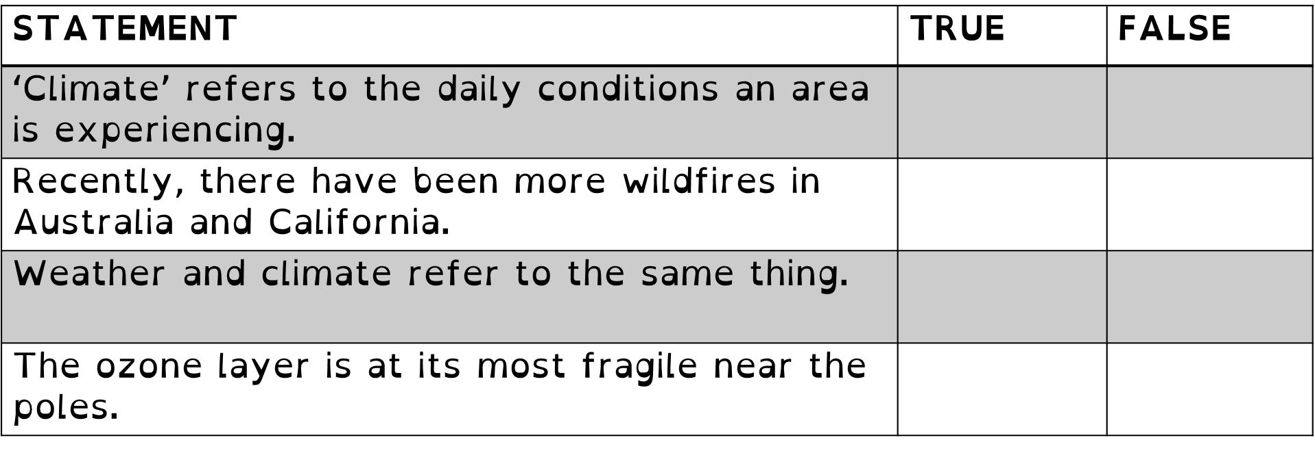
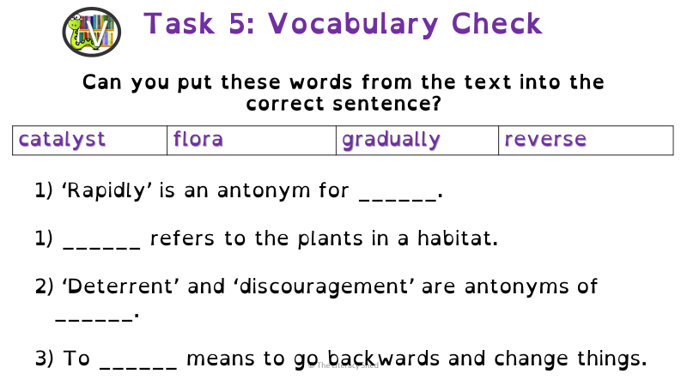
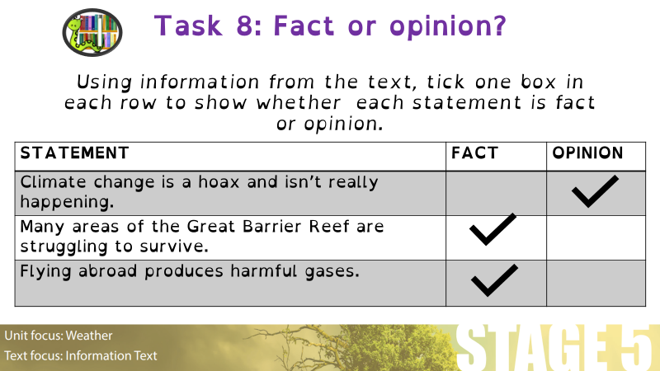
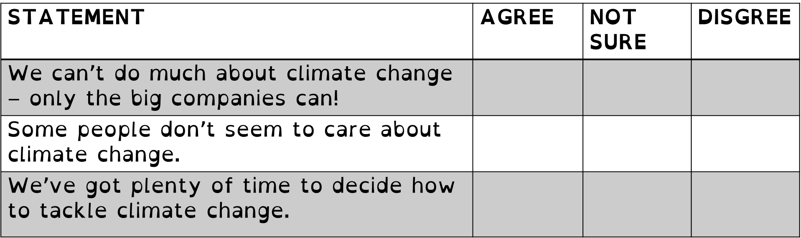

Slide 14
Reading For Pleasure
Whole class books will become our new ‘story time’ which is reflected in the Reading Framework.
Children will still have a book to follow whilst the teacher continues to model that expert prosody.
Vocabulary, punctuation, context, audience and purpose can still be discussed but it should mainly be just a story.
Your reading for pleasure can still form part of your writing process and often makes sense to use these texts for writing rather than introducing another book.

Slide 15
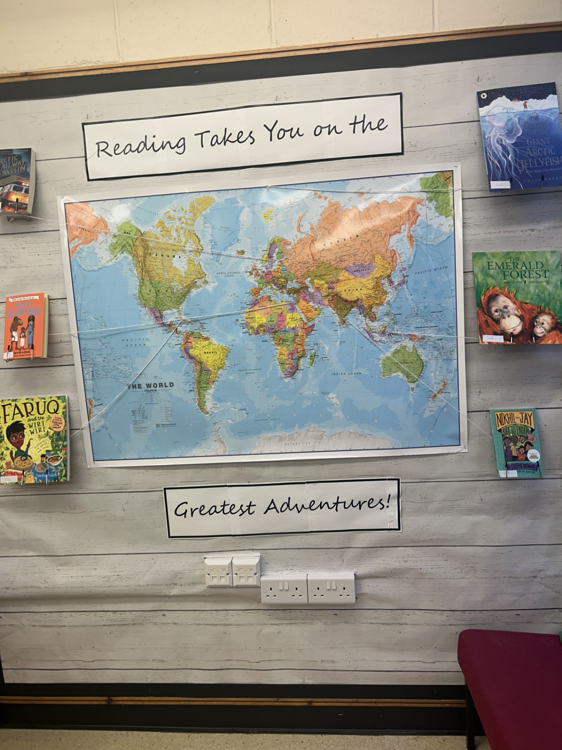
Reading Environments
Books will be available around school in all our new pop up library areas for children to take home.
The Library will become a book store as many resources from the SEND are being taken/moved/broken with children visiting unsupervised. Classes can still go in but with adult supervision only.
Many displays are now reflecting the reading culture we have at Netherton. Forward facing books, books supporting equality, diversity, RSE, SEND
Art that is representing a book shows good links. Just ensure there is a blog about the author, promote other books that the author may have written. If you liked this book, then you may like this….

Slide 16
Assessments
Using Test Base Autumn 2, Spring 2, Summer 2
https://www.literacyshedplus.com/en-gb/browse/reading-shed/comprehension-plus/sats-practice
Children that are borderline/WTS should be put on the HFL Reading Intervention
Groups of 6 – 8 children
Takes 6 weeks to run at two x twenty minute sessions per week
Complete the Yark baseline at the start and then again at the end.

Slide 17
Thank you

Slide 18
Spelling @Netherton
Cracking Spelling
Diane Stinson

Slide 19
Cracking Spelling & changes to spelling delivery
Spelling tests will be no more. Research shows it has very little impact on implementation.
Many children learn them for the test only
A lot of spellings are not common words that children will even use or have heard of before!
Creates anxiety for children who struggle to get a good result
Not enough exposure to spelling rules and patterns and seeing words in lots of different contexts.
Cracking Spelling links spellings to grammar by colour coding
Children learn five spellings rather than 10 and use of dictation and mirroring GPS test is the way to assess and monitor.
Spelling Shed will still be available until July next year
Upload and create your own spelling lists so children can still access learning at home.
Show PPT on Cracking Spelling

Slide 20
