Slide 1

Welcome to Year 2

Slide 2
Staff
In Year 2 our staff are:
Miss Reid
Class Teacher
Mrs Harmsworth
Teaching/Support Assistant

Slide 3

Communication
School newsletters are sent out every Friday via ParentHub. These include lots of information about school events etc.
We ask all parents to ensure that they read the newsletters as they will inform you of important dates and happenings in school.
ParentHub is also used by class teachers as a way of communicating with parents regarding their child.

Slide 4

Routines
Snacks and Milk
Children are entitled to a free piece of fruit provided by school – snack money is not needed.
If your child would like milk on a daily basis, you can order this via Paynes Dairies as suggested on parent hub.
We ask that you please send your child with a filled water bottle each day. Juice is not allowed.

Slide 5
Homework
One piece of homework will be given out every Friday. This should be returned to school by the following Wednesday.
Homework should be completed in pencil (unless specified otherwise e.g. art activity).

Slide 6
Spellings
Spellings will be sent home on the first Friday of every half term in the form of a spelling tracker. This will be differentiated depending on your child’s ability.
These spellings will link to our phonics (first half term) and the spelling rules learnt in class.
Please practise these with your child as they will have a spelling quiz every Friday!
The children will do their spelling quiz in their spelling books so please ensure your child’s spelling book is in their bag.

Slide 7
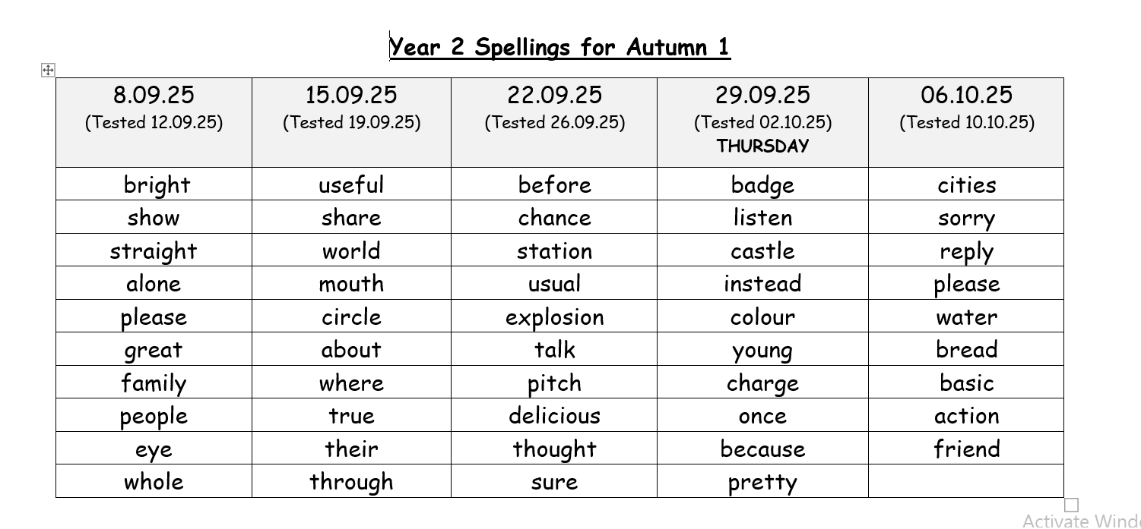

Slide 8
PE
PE will take place on a Wednesday afternoon and a Thursday afternoon.
Please ensure that your child has the appropriate PE kit for both indoor and outdoor PE with them at all times, as this can change depending on the weather.

Slide 9

Phonics
In Year 2, we will still follow the Little Wandle scheme for Phonics and Spelling in Year 2.
If your child passed their Phonics Screening check in Year 1, they will revisit phonics for the first half term, before moving onto spelling rules for the rest of the school year.
Phonics lessons take place every day.
Some children may require daily keep up phonics interventions which they will do in addition to their phonics lessons in class.
If your child didn’t pass their Phonics Screening check in Year 1, they will take the check again whilst they are in Year 2 (June).

Slide 10

Reading at home
Your child will bring a reading book home next week once I have heard each child read. They will be given a reading book which is appropriate for their reading level. Some children will continue to read the Little Wandle books to support their phonics. Other children will be given a colour banded book.
In the Spring term, children who are ready, will move onto our ‘reading for pleasure’ books. This means they will be able to choose any book of their choosing, without a colour band or level.
They will also bring their reading diary home. Please read with your child as often as possible and record in their diary. Ideally, reading should take place everyday, but a minimum of 3 times per week.

Slide 11
Assessment in Year 2
SATs in KS1 are not statutory.
The children will still take part in assessment tasks for reading, maths and grammar/spelling, but these will be done in a calm way. The children will remain in the classroom or shared area which will be what they have been used to all year.
The work that the children produce on a day to day basis will inform my teacher judgements. The assessment tasks are a way of allowing the children to show me what they can do!

Slide 12
Uniform
Please take the time to read our updated uniform policy which was sent out on parent hub.
Please can all uniform be labelled including PE kit. This helps to prevent lost school uniform.

Slide 13

Concerns
If you have any concerns at all please do come and see me at the classroom door to make an appointment, or contact the school office. The appointment can then be face to face or on the phone depending on preference.
We are encouraging all parents to come and speak with us first rather than posting comments on social media sites as this can often escalate problems rather than sort them.

Slide 14
Thank you!
Thank you for taking the time to read this information. I hope it has outlined a few important things for you as your child transitions into Year 2.
If you have any questions, please feel free to speak to me at the classroom door before or after school.

