Slide 1
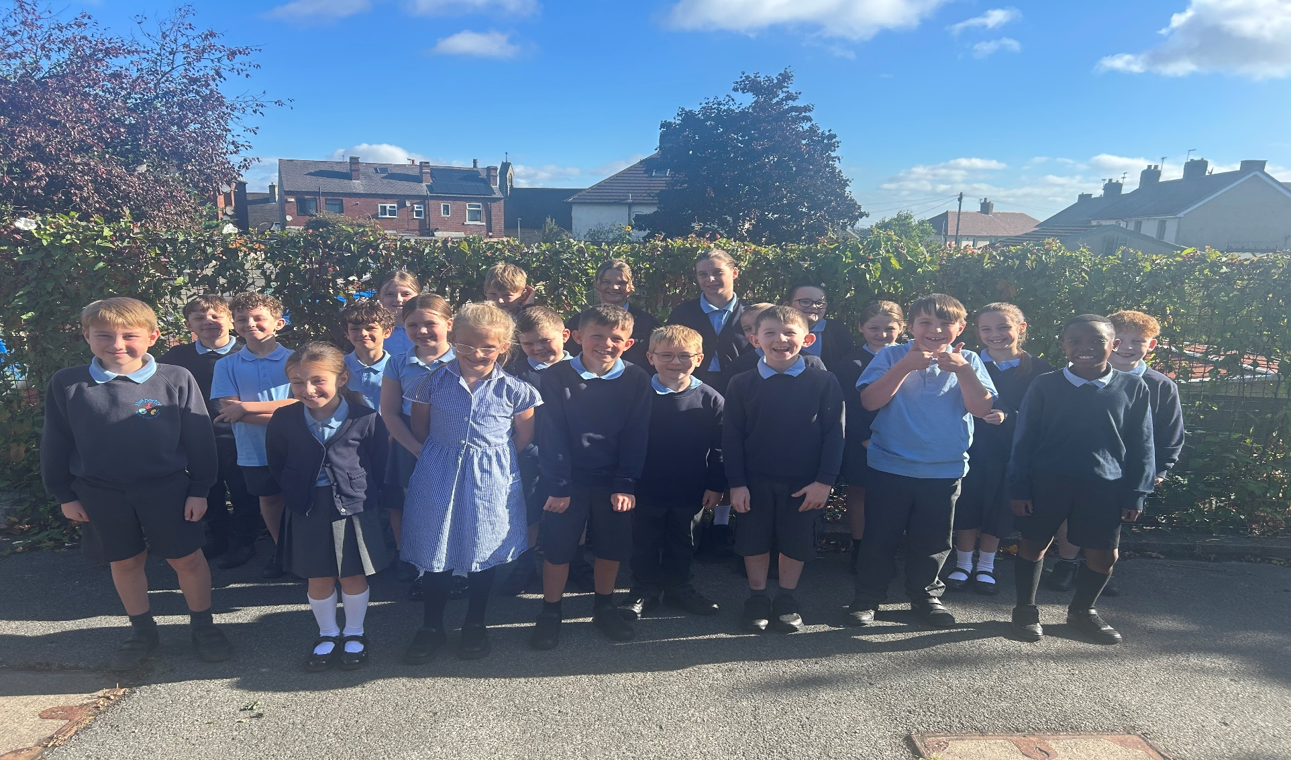
Welcome to Year 5

Slide 2
Staffing structure in Year 4/5
Mrs L Douglas – class teacher
Mrs Petts– KS2 Teaching Assistant
Mrs Mason – KS2 Senior Teaching Assistant
About myself.
I have been a teacher for 14 years and worked in almost all year groups and started in the Early Years.
I am the lead on English and Assessment for all pupils at Netherton.
I am a designated safeguarding leader for our school and I form part of the senior management.
I have two children so I can empathise with missing pe kits days, letters and non-uniform days!
My vision is for all children to feel safe, happy and to have fun whilst learning.

Slide 3
Year 5 Topics
This year we have some exciting topics which I think the children will really enjoy! Our topics in the order which we will study them are:
WW2. We will be holding a parent involvement day on the 10th October and the theme will be around WW2. Lots of cooking and construction on the day!
Frozen Kingdom! Looking at the polar regions and the wildlife and habitats of both continents. We also research the adventures of Ernest Shackleton and explore this further in our English lessons. I have booked a trip to The Deep on the 10th November and a workshop to explore the life of penguins.
Ancient Greeks. This is after Christmas and I am are hoping to book a visitor in for the day to compliment the learning surrounding artefacts.

Slide 4
Cont…
Rolling Rivers and The Water Cycle follows on and we will be going on a trip to the Yorkshire Water plant at Sheffield on the 30/4/26. This also supplements are next topic on renewable resources.
Renewable resources. This looks into how we can be more energy efficient and how we can improve our carbon footprints. It looks at the distribution of natural energies.
Going Local is our final topic with a good combination of history and geography knowledge. We will be planning a walk to our local school Middlestown with a planned lunch stop at the Grumpy Fryer!

Slide 5
PE Days
Our PE Days are Monday morning and Wednesday afternoon. The children will come home in their kits on Wednesday as it is the last session.
Indoor PE kit:
Shorts
T-shirt
A spare pair of socks
Outdoor PE kit:
Shorts
T-shirt
Trainers (suitable for outdoor games)
Plain black or navy tracksuit

Slide 6
School Uniform
Standard school uniform – See website
Plain grey tights/dark socks
Black school shoes (no trainers)
No jewellery to be worn
Hair must be tied back if it is longer than the shoulder.
If there is light rain the children will still go outside to play. As the weather gets colder and more unpredictable, please encourage your child to bring a coat to school.
Please ensure all possessions are labelled. Our lost property will be disposed of termly as we don’t have the storage space to keep it, if items are labelled we can return them home to you!
New this year, so we can get the children out as much as possible, is to have a pair of wellies so we can access the school field for more that three months of the year!

Slide 7
Behaviour
We are currently modifying our behaviour policy and this should be available soon.
I am all for positive behaviour management and I have this year introduced some new incentives to encourage making the right choices and having a positive growth mindset.
Shout out cards, teacher mail cards, golden nuggets, headteacher/SLT visits, stickers and then our whole school certificates.
Children will be asked to consider their choices if they are distracting others in the class. If they continue to cause disruption then they will be asked to join an SLT to further consider their behaviour.
I consider myself to be a fair but firm teacher and would rather reward than sanction. I want to get the best out of all my learners and so we have put together a class charter to show how we can all achieve this and be the best we can be.

Slide 8
Water Bottles
Only plain water is allowed in children’s water bottles, nothing else.
We do have plastic cups in classrooms for children to use if they don’t have a water bottle but we urge children to bring in their bottle.
If your child would like a drink during the day other than at lunchtime, please ensure they bring a water bottle.

Slide 9
Reading
Over the next week, children will be allocated their KS2 reading books. Children will take these home and will be encouraged to read at least three times a week. The new government Reading Framework Guidance 2023 stipulates that children are no longer given colour banded books to read but should be encouraged to read for pleasure. We therefore direct children to books that we feel will match their reading ability and these can be taken from the library or the pop up book shelves we have distributed around the school. In upper key stage two, we do not have reading records anymore as they were not being used correctly. We have a recording book in the classroom we log each book taken in/out so we will be monitoring reading this way rather than individual reading logs.
Even as your children gets older and progress through school, reading aloud to other people at home is extremely beneficial in terms of improving children’s reading and understanding. Please keep doing this if possible!
Books can be changed at anytime but we do check that the children are taking home a good mixture of fiction and non-fiction texts.

Slide 10
Homework
The children will receive maths homework every Friday and should return it to school completed by the following Friday. The maths homework will reflect what they have learnt that week.
If homework is not completed 3 consecutive times, parents will be contacted to check if there is anything we can do in school to support.
Spelling Shed and TTRS logins went home on Friday and children are expected to access these weekly. If they do not have access to devices then I can find time in the school day to allow them to complete their assignments.
I will also send home each half term ideas for further homework/activities that may compliment other areas of the curriculum. These are only suggestions and are not monitored.

Slide 11
Spellings
Weekly spellings will coincide with our whole school spelling approach. Children will have two discreet spelling sessions each week to enable them to learn the spelling rules. Spelling trackers are sent home every half term and are also available on the website.
Children will normally be learning their year group spellings but if they require additional catch up or year group spellings these will be set on their Spelling Shed devices. Your child may have two assignments to help them however they will only be tested on the main group of spellings. These will be indicated on the tracker that is sent home.
All children will be assigned their new Spelling Shed login and spelling homework will be assigned as part of their home learning.
Spellings refresh every Friday after they have had their test.

Slide 12
Other Information
We will be having a parent consultation in October to report on how children have settled back and to discuss future steps and any concerns. You will receive a full termly report in December indicating your child’s progress throughout year 5 so far.
Children don’t receive free fruit in KS2, however it is fine for children to bring a piece of fruit from home to eat at playtime or a snack bar.
If children are walking to the car park or there is a change to pick ups, please could you let me know in person either by email or phoning the office.

Slide 13
Concerns
If you have any concerns with regards to school then please feel free to speak to any of the class teachers or a senior member of staff.
Please refrain from contacting other members of staff, for example the dinner-time supervisors.
Social Media
Please avoid messaging members of staff.
Posting comments with regards to concerns.

Slide 14
Newsletter
Please ensure that you read the weekly newsletter as this will contain not only important information about school, but class specific details.
This can be emailed.
We also have Parent Hub which I will regularly post on.
I also enjoy posting what the children are getting up to in their learning on our school Facebook page. Make sure you are signed up! Please let me know if your circumstances have changed and you do/not want your child on social media.

Slide 15
Finally, if you have any questions or concerns about anything mentioned here or anything else, please don’t hesitate to call in and see me.
Mrs L Douglas
ldouglas@netherton.wakefield.sch.uk

Slide 16


