Slide 1


Friends of Netherton PTA
Registered Charity Number: 1189391

Slide 2
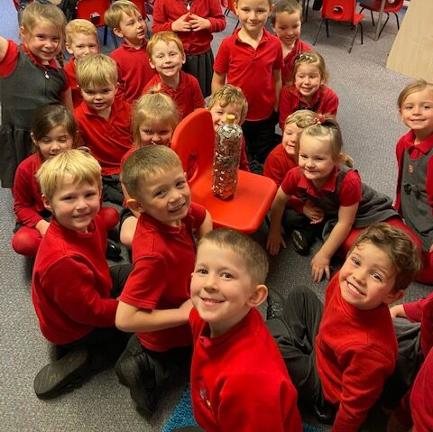

What do we do and why
The primary purpose is to raise money to fund activities and resources that aren’t covered by the school’s budget
Our main aims are to:
Provide the very best for your children
Plan fun and interactive fundraising events
Create a friendly network of like-minded parents
Raise as much funds as possible!
School spend from PTA funds will be £6,235 in the 2020/21 School Year

Slide 3
How We Raise Funds
Discos
Christmas and Spring Fayres
Bags to School
5p Challenge
Raffles
Fashion Shows
Netherton J&I School
School Fun Days
Christmas & Special Event Cards
Amazon Smile
Hampers
The PTA has raised over £3,000 this school year without being able to host events

Slide 4
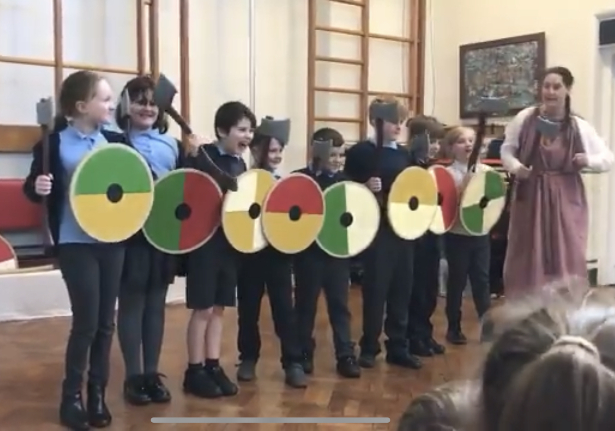
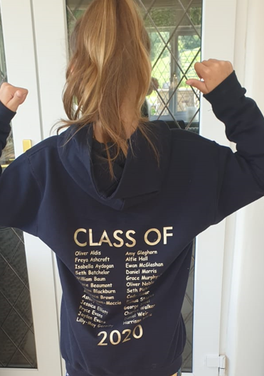
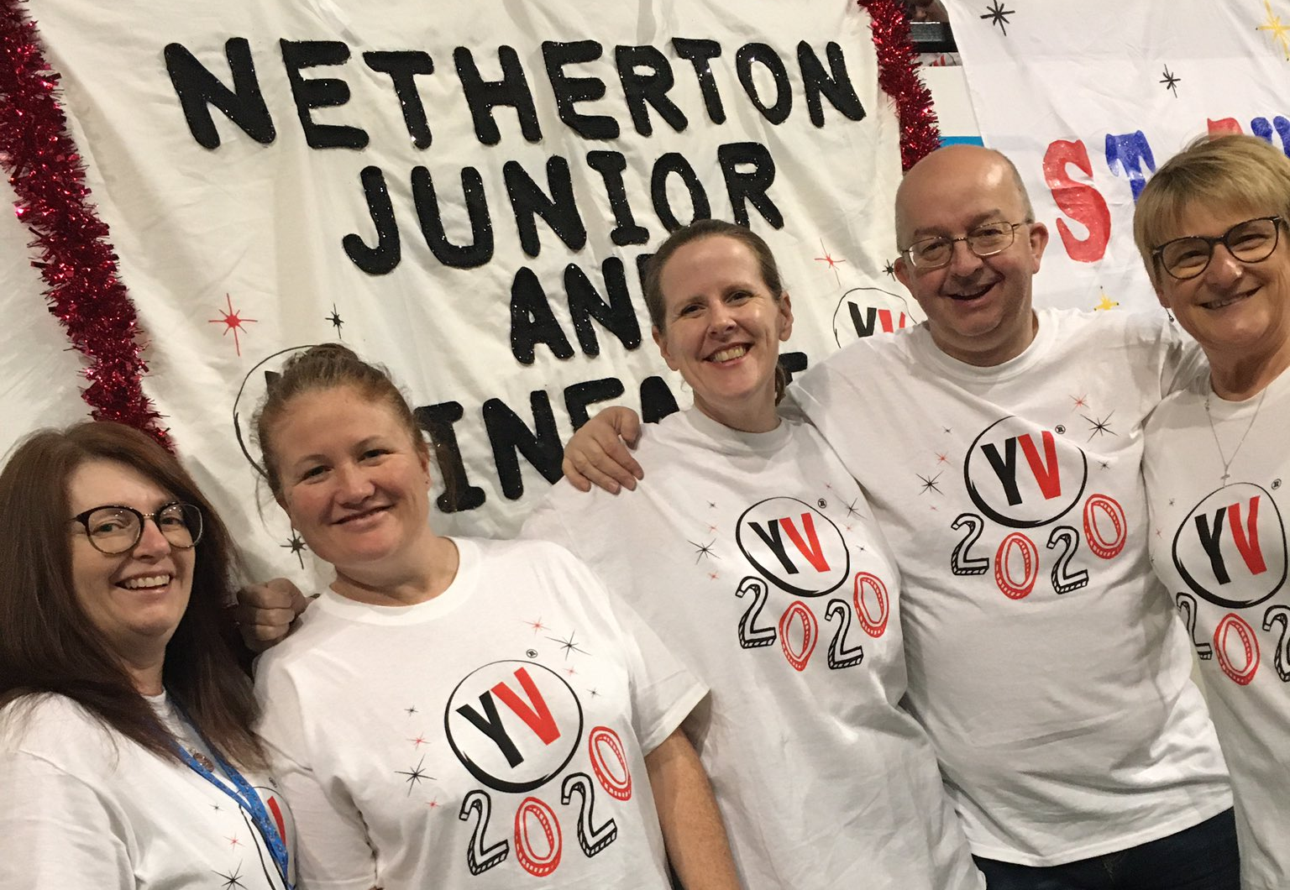
How The Money is Used
Car parking
PE Equipment
Pantomime
School Council
Themed Class Days
New Sports Kit
Young Voices T-Shirts
Chess Club
Leavers Hoodies
Library Books
Trophies
Music Equipment
The PTA contributes over £800 a year so parents can use the club car park

Slide 5
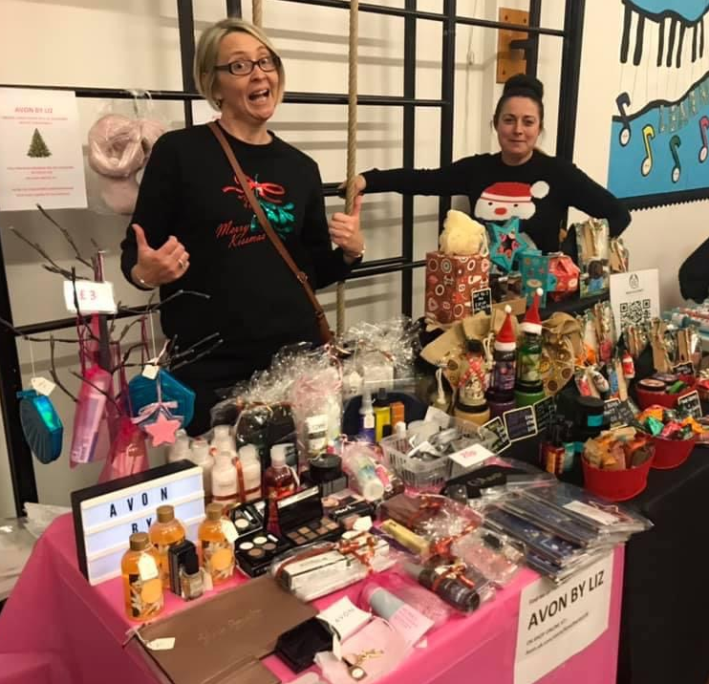
What can you do to help?
Help is desperately needed and very much appreciated, devote as much or as little time as you can
You can help in the following ways:
Assist at events, e.g. selling raffle tickets or hosting stalls
Attend meetings to help organise events and/or make suggestions for future fundraising
Speak to local businesses about sponsorship for events or sports kits
Interact with the teachers about how the funds are utilised
Donate prizes
Our members commitments vary considerably based on their own free time

Slide 6
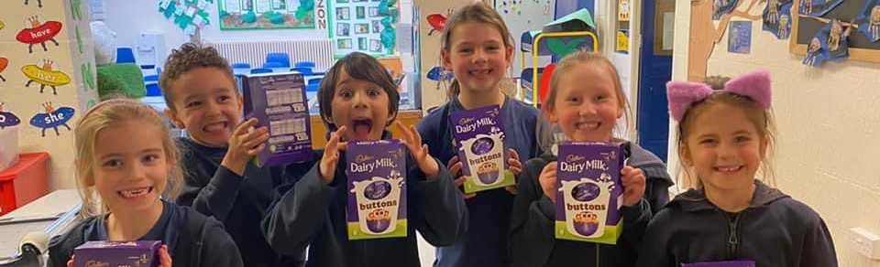
Feel connected, be involved with the school
Be a role model
Make a difference in your community
Be part of a great network
Make sure your children experience event such as the themed days (which the kids love!)
Remember, it’s not just for mums!
If you can’t spare the time then please remember to support the PTA events and fundraising
Final Words

